Slide 1
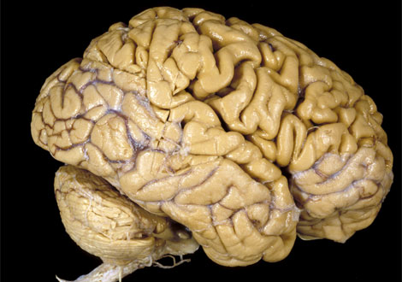
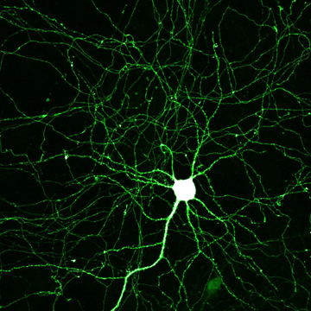
Seeing Your Brain
How the brain works across scale
Notes:
Orders of magnitude magnifaction to look at biology. Comparative numbers.

Slide 2
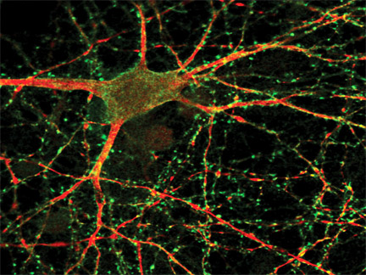
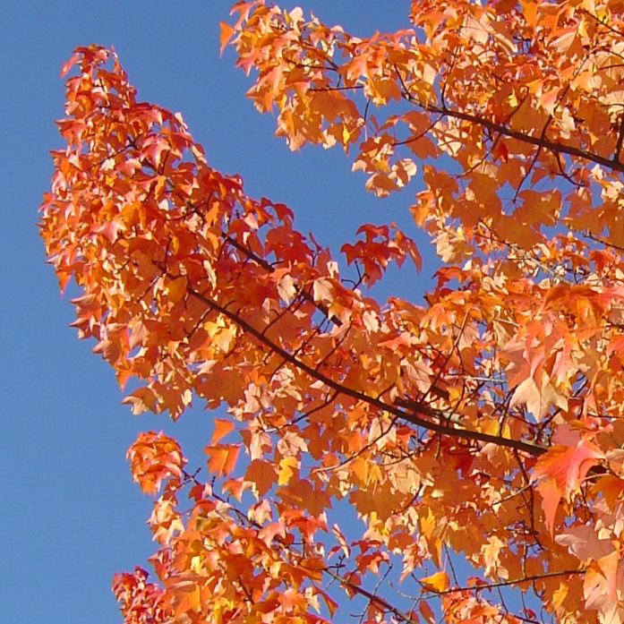
Neurons and Synapses
Cell body
(soma)
Root
(Axon)
Branch
(Dendrite)
Connection
(Synapse)
Notes:
Tree: 10-100k leaves; neuron: 10-100k synapses; “arbor”

Slide 3
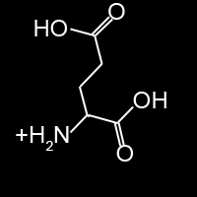
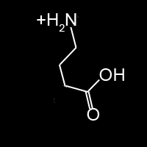
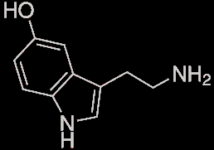
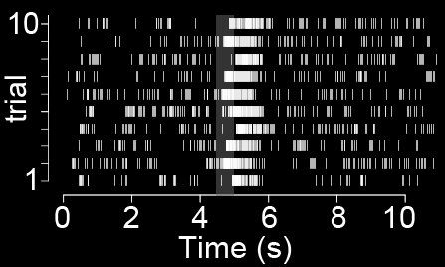
Synapses Make Connections
Specificity by chemical keys
Fast, transient
Plastic
Glut.
GABA
Serotonin

Slide 4
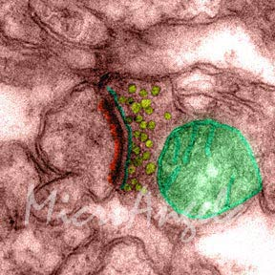
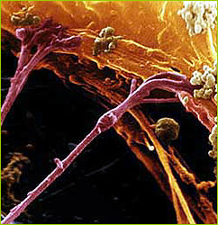
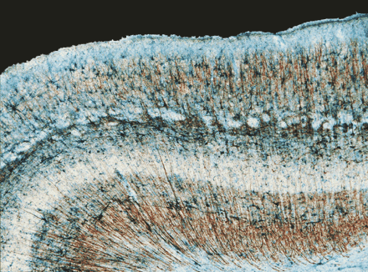
Complexity From Scale
200 billion neurons/brain
x 50,000 connections/neuron
= 10 quadrillion connections/brain!
x100
x100
1 μm
10 nm
0.1 mm

Slide 5
Facebook Friends vs. Synapses?
400 million Facebook users
× 65 unique connections (“friends”) per user
= 26 billion “Facebook friend” connections
10,000,000,000,000,000
÷ 26,000,000,000
384,615
So… 1/385K^{th} of the connections in your brain!

Slide 6
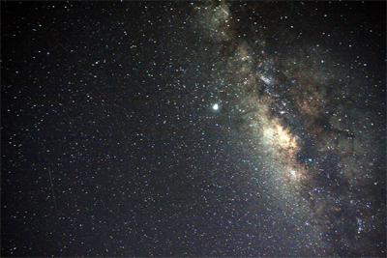
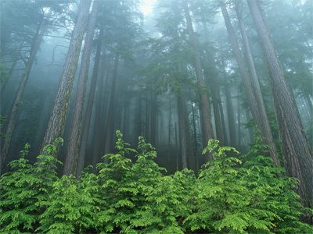
Hard to Find 10 Quadrillion Anything!
100 billion stars in the galaxy
10,000 synapses per star!
Leaves in Olympic Forest
300 synapses per leaf!
1 synapse/leaf = CA + OR + WA 100% covered in forest!

Slide 7
Missed Connections
Synapses form to predict reality.
No prediction is perfect. Why?
What you see ain’t what you get…

Slide 8
How About 10²⁵ Something?
10 quadrillion synapses/brain
× 7 billion human brains
= 7x10²⁵ human synapses
10²⁴ grains of sand on Earth!
10²² stars in the universe!

Slide 9
Internet as an AI?
7 × 10²⁵ synapses
× 200 signals per second per synapse
= 1.4 × 10²⁸ human brain bps
1 billion PCs on the Internet
× 10 Gigabits/s connection
= 1.2 × 10²⁰ internet bps
Internet ~= 1 human

