Slide 1
Hindu YUVA
Bouddhik Evening
February 26, 2011

Slide 2
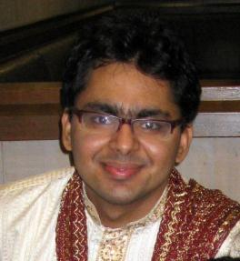
Speaker Profile
Pursuing PhD at University of Washington
Research: Computer Vision and Graphics
Deeply interested in history, politics, travelling and adventure sports.
Ankit Gupta

Slide 3
INDIA
The journey of a Nation.
From Independence to a Republic.
Notes:
Namaste everybody. My name is Ankit Gupta and today I will be talking about India, its story from getting independence to becoming a republic.

Slide 4
Outline
Motivation
Freedom and parricide
Gathering the pieces
The constitution
Conclusion
Notes:
I will first give a motivation to why I started reading on this topic and why it is important to all of us too. I’ll first talk about the period around freedom which included the unfortunate partition, its aftermath and how we coped up with it. India was not one country when we got independence, there will small kingdoms everywhere. How they were got together to build this one nation will be the next part of my talk, which I have titled – gathering the pieces. Lastly I’ll talk about some key issues when our constitution was being designed, the ideas of our nation that were discussed at that point of time.

Slide 5
Motivation
Curiosity.
  For most of us, history ends at 1947
Awareness.
  To become better citizens.
Philosophy.
  What defines and unites India?
Notes:
For most of us who ended up not to choose history as a subject of study after Grade 10, the Indian history ends at 1947 when we got independence. We get to know almost nothing about the events that shaped our country like the partition, the Kashmir conflict, the Communist troubles, Emergency periods, Operation Blue Star and the list goes on. So just out of curiosity one would want to know what happened to our country the outcomes of some of which are still troubling the country. We need to be aware about these things, the ideas of our nation, to become better citizens. And most importantly, studying this starting period specifically makes us think about what unites India and defines it. A question over which I have been pondering for a very long time now. And hence I started my quest with reading different sources and compiling them as this presentation today.

Slide 6
Freedom and Parricide
1947-50
Notes:
The first part of my talk would be about the freedom which came with the country’s partition, its aftermath and how we coped up with it.

Slide 7
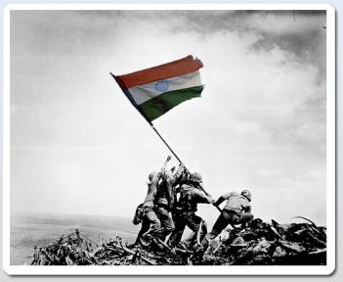
India: Aug 15, 1947
Purna Swaraj Declaration on Jan 26, 1930.
Second Anniversary of Japanese surrender.
Chosen by Lord Mountbatten
Notes:
India got its independence on Aug 15, 1947. But have you ever wondered why was this date chosen? The Congress had first celebrated India’s independence day on Jan 26, 1930, a day which they called for Purna Swaraj Declaration. Every year since then, the people celebrated this day as our Independence day. Then why was Aug. 15 chosen as our day of freedom? The day was chosen by Lord Mountbatten because it marked the second anniversary of Japanese surrender in World War 2. Even the day of leaving India had a sense of British supremacy about it.

Slide 8
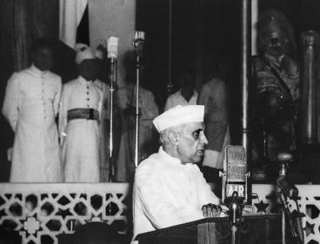
The Ceremony
Started at 11pm on Aug 14.
Three speakers
  Chaudhury Khaliquzzaman
  Dr. S. Radhakrishnan
  Pt. Jawaharlal Nehru
Notes:
The ceremony started on Aug 14, 11pm since it was decided that India will get its independence at the stroke of midnight. It is also said that astrologers believed that Aug 15 was inauspicious so the ceremony should at least start the day before. There were three speakers that day. The first speaker was Ch. Khaliquzzaman, chosen to represent the Indian Muslims. Then was Dr. S. Radhakrishnan who was a very good orator and was known for his work of uniting Western and Eastern systems of politics and governance. The final speaker was Pt. Jawaharlal Nehru who was also going to be the first Prime Minister of the country.

Slide 9

Pakistan: Aug 14, 1947
Allow Lord Mountbatten to attend both ceremonies
To show, Pakistan did not secede from India.
Notes:
A day before India got its independence, Pakistan marked its Independence Day on Aug 14, 1947. One could argue that both countries should have gotten freedom on the same day but historians have noted some reasons for it. Primarily Lord Mountbatten would have been there in both the ceremonies so for his convenience, the days were kept separate. And further, Pakistan chose to schedule its independence before India so that it does not look like they broke away from India.

Slide 10
What led to partition?
Need to go back in time
Notes:
But to really answer the question of what led to splitting of the country, we need to go back in time a bit.

Slide 11
The Early Cracks
Divide and rule politics by the British
Feeling of separatism – Khilafat Movement
Congress’s ignorance of the Muslim League
Notes:
The early cracks between the Hindu and Muslim community can be traced back to the divide and rule policy of the British whose consequences were the job reservations for the communities and the Bengal partition in 1905. The second factor is usually considered to be the support that the Congress leaders decided to provide to the Muslims for the Khilafat movement in Turkey. The Khilafat movement was based on the loyalty of Muslims towards a religious leader outside and one can say that India took a back seat to the religion here. The last factors that many historians consider is the ignorance that Congress showed to the Muslim league. It is said that Jinnah was ready to make a deal with Congress in 1930s but Congress thought he did not have any support. But then later in 1940s, things had changed drastically.

Slide 12
Rise of Muslim League
Led by Mohammad Ali Jinnah.
1927: ~1300 members, 1944: ~500,000 members in Bengal alone
Fear of a ‘Brahman Baniya Raj’
March 1940, first call for Pakistan.
Notes:
The rise of the Muslim League was very steep. The membership grew from about 1300 in 1927 from 500,000 in the state of Bengal again. The basis behind its promotion of the fear of the Hindu nation being formed after independence in which Muslims will be exploited. In 1940, the Muslim League made the call for a separate state of Pakistan for the first time. And the events that followed this did not help the situation.

Slide 13
Cripps Commission (1946)
“there is more likelihood of obtaining Hindu consent to Division than Muslim consent to union”
“to unite India against Muslim wishes would necessarily involve force. To divide India against Hindu wishes would not”
“the Hindus may loudly lament their brethren in Bengal and Punjab being torn from Mother India, but they are not likely to have the will to undertake a crusade on their behalf”
Notes:
In 1945, after the World War II ended, the government in Britain changed and Clement Atlee became the Prime Minister instead of Winston Churchill. The new govt. was willing to negotiate India’s independence and sent the Cripps commission to India to see how the procedure will follow. In 1940, the Muslim League had already made a call for Pakistan and with a lot of public support now, they were not willing to stand back from their demands. Here, I have noted some observances of the commission at that time which clearly indicates the lack of unity amongst the Hindus in the country. While the commission was afraid of not consenting with Muslim state wish, they were more willing to face the opposition by Hindus since it won’t be so strong. It shows why we need a united India even today for the world perception needs to be changed.

Slide 14
The Elections (1946)
Total seats: 1585
Congress: 927, Muslim League: 429
The partition was inevitable
Notes:
To look over the process of independence, the British organized elections in India. Out of 1585 seats in total, the Muslim League won a whopping 429 seats. And once they had such a big representation from the people, they were not willing to make any negotiations on the separate state demand. The partition was inevitable.

Slide 15
What led to partition?
Congress’s shortsightedness
Jinnah’s ambition
British amorality and cynicism
Notes:
Just to summarize, the historians have generally looked at three major factors behind India’s partition which we have already discussed in the past few slides. (1) Shortsightedness of the Indian Congress to gauge the danger the Muslim League could pose later. (2) It is said that while Jinnah was fighting hard for the Muslim cause, he himself did not adhere to the practices prescribed by Islam much. So the demand for a separate state of Pakistan is many times attributed to his personal ambition of ruling a new state. (3) One of the main reasons was I feel the divide and rule policy of the British which played a major role in harvesting the feeling of enmity in the Muslims of the country against the other communities.

Slide 16
The Massacre
Reported figures for Aug 1947 – 15,000 killed
Overall toll: 1 million dead (reported).
Notes:
And once the decision of partition was announced in June 1947 on the radio, large migration and riots started through the country. And about 1 million people were reported to be killed and the actual numbers are believed to be at least two times this figure.

Slide 17
Could this have been prevented?
The original plan of leaving India in June, 1948.
The delay in announcing Punjab boundary.
Improper use of the armed forces.
Notes:
There are some British decisions that I want to focus your attention to here which are now more like thought experiments. (1) The original plan of the British was to leave India in June 1948 since they thought that they required that much time to leave India with a stable political system. But then they left on Aug. 1947. Why? Because seeing the situation in the country they knew that no matter when they left, the riots were to happen and lot of turbulence would be there. So they wanted to leave India as soon as possible to avoid the responsibility and hence the date August 15, 1947 was chosen, which was also the 2nd anniversary of Japanese surrender in World War II, and was a day of pride for the British. Think if the British had decided to stay longer and slowly made the transition to independence, would the resulting violence have been lower? (2) Once the decision of the partition had been made in June ‘46, Lord Radcliffe was assigned the task to draw the division boundaries. But strangely, the boundary in the North-west region was only declared on August 16, 1947 even though it had been decided earlier. The North-west border was very critical region since it was a common stay for both the big communities – the Hindus and the Muslims. The British knew that once the boundary had been announced, the turbulence was bound to happen immediately and they did not want to announce the boundary till the control went out of their hands. Again, an act of avoiding the big responsibility. Maybe if the decision over the boundary had been announced earlier than the actual independence of the two countries, the toll would have been lesser? (3) As another unfortunate thing, much of the armed force during this period of violent turbulence was used to secure the escape path of the British nationals living in the country. By staking thousands of lives of natives, to use the armed forces to guarantee safety for a bunch of nationals was certainly not a very smart decision by the British.

Slide 18
Aftermath (1947-49)
The biggest migration in World history.
~8 million people coming into India.
More than populations of countries like Austria, Norway. Almost equal to Australia!
Notes:
The partition of our motherland was very unfortunate. Apart from the people died, this event also led to the biggest migration ever seen in the world history till now. Approximately 8 million people came into the current India from the current Pakistan and the current Bangladesh. Just to give you some idea about the scale, this number is more than the populations of some smaller European countries like Austria and Norway and almost equal to the population of the whole continent of Australia. So just imagine the whole Australia moving to some other place!

Slide 19
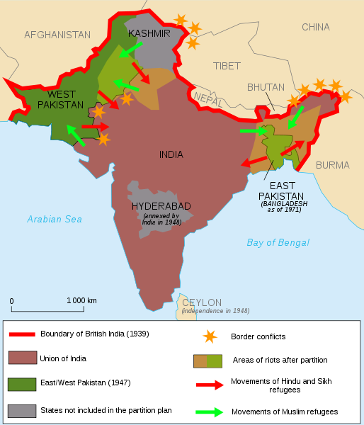
Notes:
This map shows the areas where the migration happened in 1947. You can see that the major areas of migration were the North-West, West and Eastern India. Now I will talk briefly about how each of these areas coped up with the huge scale of migration involved.

Slide 20
North-West India
~1.5 million people in.
Resettlement for farmers
  Sardar Tarlok Singh.
  Standard hectare and Graded cut policies.
Resettlement in areas like Delhi (Patel Nagar, Lajpat Nagar, Rajendra Nagar …. ), Faridabad.
Notes:
About 1.5 million people came into the North-West India from Pakistan. These people initially stayed in the refugee camps. Kurukshetra was the main camp site for the refugees. Many of these immigrants were farmers who left their fertile lands in Pakistan to come to India. These had to be resettled in the areas vacated by the people in current Indian states of Punjab and Haryana who had moved to Pakistan. But the problem was that the available vacated space was much lesser than what these people had left. Sardar Tarlok Singh, who was a civil services officer led the resettlement of these farmers. To solve the land allotment problem, he came up with two schemes – the concept of standard hectare and graded cut policies. I am not explaining these policies here but they led to a reasonably fair allotment of land to a large share of the immigrants. The other people who had moved in from Pakistan flooded the areas of Delhi and around it. The current colonies of Patel nagar, Lajpat Nagar and Rajendra Nagar are only some of the colonies that these people created and settled in Delhi. Just to mention, the current town of Faridabad was specially setup for these new immigrants only.

Slide 21
Eastern India
~400,000 immigrants in Calcutta alone.
Inefficient settlement plans.
Strengthening emergence of communism.
Notes:
Eastern India presents another perspective to the problem which also connects to some current political problems. About 40,000 immigrants came into the city of Calcutta only. There were vacated areas here too from the people had moved to the current Bangladesh. The difference though was that the resettlement plans were not efficient. There were problems like home and food shortage. And these bad living conditions of people fuelled the rise of communism in the area.

Slide 22

The rise of communism (1948-50)
Led by B.T. Ranadive.
Inspired by Mao Zedong in China (‘49) and Soviet.
Support in dissatisfied people in Eastern parts and in Hyderabad.
Notes:
Communists were already prevalent in the Eastern region and were led by their new leader B.T. Ranadive. They got bolstered by the victory of Mao Zedong in China in 1949 and were also being supported by the communist elements in Soviet. The dissatisfaction of the people with the shortage of food or homes in the region led the communists to establish their philosophy strongly amongst the crowd. And slowly this philosophy percolated in the interiors and found support with the farmers who were not satisfied with the government policies then. And this led to the current problem of Naxals too.

Slide 23
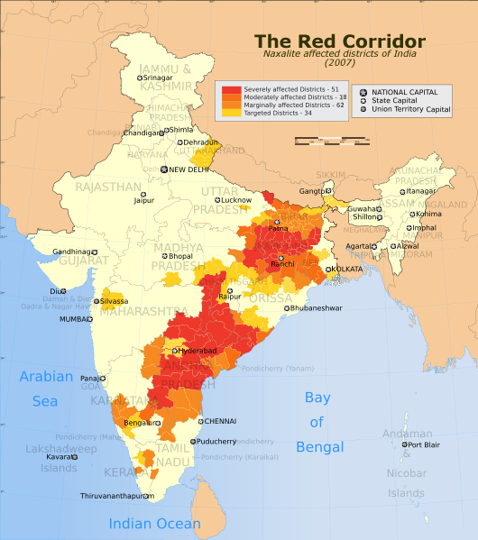
Notes:
This is the map of India from 2007 showing the areas affected by the Naxalites. You can make some connection how the communism spread and took its stronghold in form of Naxals in the eastern regions going into the areas of Andhra Pradesh, Jharkhand and Bihar.

Slide 24
West India was different
~500,000 people in Bombay camps.
No empty areas for them as in earlier two.
  Spread in Bombay, Pune, Ahmedabad, other cities.
Increase in slums, fight for housing, jobs.
Notes:
West India presented a much more difficult problem for the migration because there were not as much vacated areas here. It only saw the incoming people from the state of Sind. So settling the immigrants here was much hard and was not accomplished well. This resulted in setting up of big slums and fights for housing and jobs in the region. Lot of the immigrants settled in the cities like Ahmedabad, Pune, Bombay etc.

Slide 25
Gathering the Pieces
1947-49
Notes:
Now we will talk about the second component of the talk which is about the geographical integration of India.

Slide 26
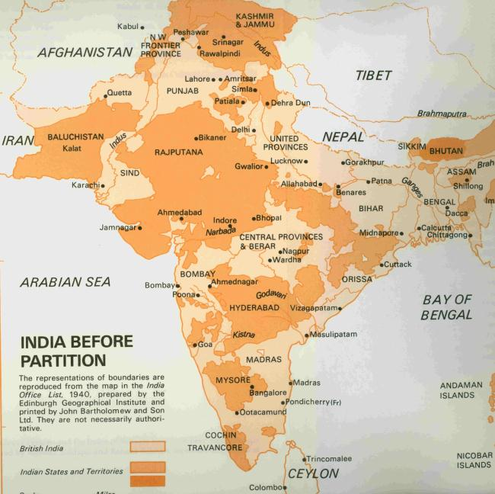
Notes:
India before partition was a “basket of apples”. Besides the British empire, there were over 500 small kingdoms which had some sort of a treaty or agreement with the British. In 1947, when British decided to leave they divided the part controlled by them into India and Pakistan but they did not take any decision over the kingdoms.

Slide 27
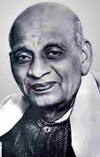
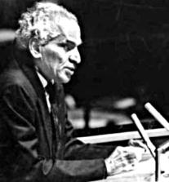
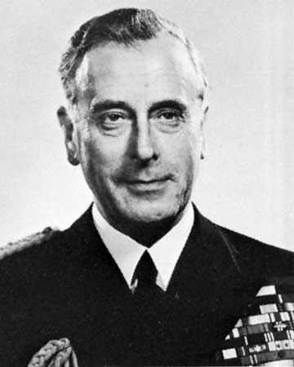
The Problem
All 565 princely states were given an option
Key men involved (New states dept. in June’47)
Vallabhbhai Patel
V. P. Menon
Mountbatten
Notes:
All the 565 princely states were given an option – either be a part of India, be a part of Pakistan or be an independent country. Getting them together was a big task which was taken up by the Home Minister – Sardar Valabhbhai Patel, his secretary V.P. Menon and the then governer-general of the country Lord Mountbatten. It should be noted that Mountbatten had closer relations with India than Pakistan which was good for the country as he also played his part in getting the states with India.

Slide 28
The Convincing
Lunch parties
Instruments of Accession
Logical arguments
  Resources
  Costs of maintaining foreign consulates
  National integrity
Notes:
Sardar Patel went about the huge task of convincing the states to come together with the motherland. Here I have listed three different mechanism that were involved in convincing. Lunch parties were hosted in which the states were asked to participate and they were talked to about the decision. The states were sent agreements of accession which they were asked to sign to become a part of India. Besides this, they were offered logical arguments on why they should become a part of India. If a state decided to become independent, they would have resources to manage themselves and handling all the trade agreements with so many small possible countries would be a daunting task for them, which could also hurt them financially. Also, if all the surrounding regions belonged to India, it did not make any sense for a state to accept agreement with Pakistan. Also, maintaining national integrity of this nation which has existed for number of centuries was given as a major reason to come together as one nation.

Slide 29

Three Troublemakers
Junagadh
Hyderabad
Jammu and Kashmir
Notes:
Till Aug 1947, all but 3 princely states had accepted to be a part of India. These three states were Junagadh, Hyderabad and Jammu & Kashmir. Each presented a different case and out of them the third still continues to hurt the country. I’ll discuss each one of them separately now.

Slide 30

Junagadh
Hindu majority population, Muslim Ruler.
Acceded to Pakistan.
  (Pak perspective: exchange for J&K)
Public outrage and revolt
  Led by Samaldas Gandhi
October 1947, part of India.
Notes:
Junagadh was the region of current Gujarat which had a Muslim ruler with a Hindu majority population. The ruler acceded to Pakistan. Pakistan had no issues in accepting the state even if it had a Hindu majority. Actually Pakistan leaders wanted to get Junagadh so that they could use it in exchange for J&K if it did not go it with them. But there was a public outrage against this decision of the ruler and a separate government was setup under the leadership of Samaldas Gandhi, who was actually a nephew of Mahatma Gandhi. The rulers could not handle the revolt and the ruler ran away to Pakistan leaving the ministers behind who then accepted accession to India. In October 1947, the state of Junagadh became a part of India.

Slide 31
Hyderabad
Key state w.r.t. geography
Hindu majority with Muslim Nizam ruler – Mir Usman Ali.
Nov 1947 – Foreign agreement signed with India.
Kasim Razvi – started Razakars group. Hindus started fleeing.
Notes:
The case of Hyderabad was more tricky than Junagadh. The state had a key geographic location. It was right between the northern and southern parts of India and if not part of India, would cut off India into two parts mostly. The plateau was also very rich in mineral resources. The population had a Hindu majority but there were a considerable number of Muslims living too. The ruler was a Muslim Nizam named Mir Usman Ali. He decided to be independent and signed a foreign agreement with India. Meanwhile, Kasim Razvi started an extremist Muslim group in the state called the Razakars. This group started to pursue open violence against the Hindus in the state who started fleeing t the nearby Indian states specially Madras.

Slide 32
Hyderabad
Problems for neighboring states too.
June 1948 – Mountbatten resigned.
Sept 1948 – Indian army sent to Hyderabad.
Sept 17, 1948 – Hyderabad part of India.
Notes:
This migration of refugees from Hyderabad posed a resource problem for the Indian states who were already trying to cope up with the immigrants from the partition. Sardar Patel had always been against this decision of the Nizam but Mountbatten had been controlling the situation till then. In June 1948, Mountbatten resigned as the governer-general and returned to Britain. Immediately after, in Sept 1948, Indian army was sent to Hyderabad and after some fighting, took control of the state. On Sept 17, 1948 the state of Hyderabad became a part of India.

Slide 33
Jammu and Kashmir
Notes:
The third case of J&K was the most complicated. It continues to be a problem even today and is a central issue between India and Pakistan.

Slide 34
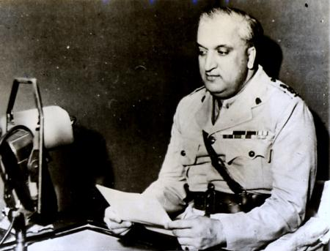
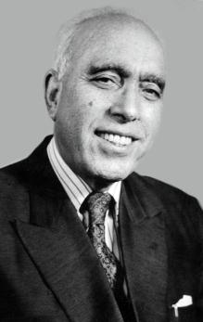
Key People
Maharaja Hari Singh
Sheikh Abdullah
Notes:
Here I show the two key people in the whole J&K issue. Maharaja Hari Singh was the king of the state at that time. Though the state had a Muslim majority, the ruler was a Hindu and did not treat Muslims properly. The Hindus were given preferential treatment in the state and slowly the unrest began to start amongst the Muslims and it was this unrest that, in my opinion, was the key to Kashmiri Muslims developing some feeling against India, who they believed again had a similar Hindu majority. The second person, Sheikh Abdullah, was a school teacher, who later became a very influential leader of the Muslim community in J&K. he had close relations with Nehru and hence was close to Congress.

Slide 35
Prevailing situation
Muslim dissent
1932 – All Jammu Kashmir Muslim Conference
Hari Singh and his minister Ramachandra Kak in favor of independent state
Signed trade agreement with Pakistan
Notes:
Because the Muslim dissent in the state against Hari Singh, All Jammu Kashmir Muslim Conference was formed in 1932 and Abdullah became its leader. It should be noted that the party did not want a Muslim state. They were in favor of all the communities living together. After the news of partition, Hari Singh and his minister Ramachandra Kak were in favor of an independent state since they could get benefits by signing agreements with the both the nations. Pakistan accepted this and signed a trade agreement with J&K while India did not sign this agreement. The trade relations with Pakistan soon had some problems and the relations between J&K and Pakistan began to deteriorate.

Slide 36
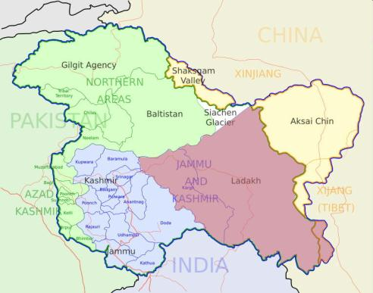
The Tribal Invasion
October 22, 1947
Notes:
J&K was divided into 5 main regions – Jammu, Kashmir valley, Ladakh, Aksai Chin and Northern areas. And then on October 22, 1947 some thousands of armed people started marching from the northern areas towards the south. There is a big debate even today on who these people were. India believes that these were supported by the Pakistan military and Pakistan says that these were just the Muslims who were revolting against the king. Because of the existing dissent there was already some armed resistance building up in the Poonch region (West part of J&K) which had a big population of soldiers who had fought for the British in the world war. This invasion has been termed as tribal invasion the historians.

Slide 37
The Tribal Invasion
Oct 24, 1947: Hari Singh asks India for help.
Indian armies enter into the state.
Early November – peace talks start.
Winter – military operations on hold.
Notes:
The advance of the invaders was very strong. They moved towards south very fast and were aiming to capture Srinagar soon and then Jammu. On Onctober 24, Hari Singh asked for India’s help and V.P. Menon was immediately sent to talk to him with the accession agreement. India agreed to help Hari Singh with its army only if Hari Singh signed the agreement which he did immediately. The Indian army entered into the state and began stopping the advance of the invaders. Once the Indian armies entered, Pakistan also publicly started supported the invaders with its army on the reasoning that “if India can, why can’t we?”. Mountbatten went to meet Jinnah regarding this but to no avail. The winter season was arriving so the military operations were made on hold. The current LoC (line of control) was roughly the border where the military operations were put to hold.

Slide 38
How things unfolded
January 1 – Move to United Nations
March 1948 – Sheikh Abdullah comes to power.
  Loyal to India.
Pakistan funded govt. of Azaad Kashmir.
The war still on.
Notes:
So now, both Pakistan and India were essentially controlling different parts of J&K. Even though officially Pakistani armies were not there in J&K, it was supporting the military resistance there and had also started funding a new government for what they called “Azaad Kashmir”. Pakistan asked India to vacate its forces before they would agree to go out. But India stood fast on its claim based on the agreement signed by Hari Singh and the claim that it Pakistan who had funded the “tribals” to come in J&K in the first place. In March 1948, elections were held in Indian part of J&K and Sheikh Abdullah came to power. Hari Singh’s powers were reduced to a nominal role only. The war between the armed forced kept on happening and the Indian army took control over some more areas.
An unfortunate step taken by the Prime Minister Nehru was to take the Kashmir issue to United Nations on consultation with Mountbatten. Sardar Patel was totally against it. At the UN, the countries mostly supported Pakistan’s stance. This international stance should be seen in light of the cold war that was building up between the West and the Soviet. The US and other Allies thought that Pakistan would be a good base to set up their armies in against the Soviet Republic. So they did not support India’s stance. Finally the UN setup a committee to evaluate the issue. The committee came to J&K and evaluated the situation but could not come to any real conclusion. It is felt that the Indian forces should have just pressed on evacuate J&K of the intruders and making the issue international only made it worse from India’s standpoint. The UN decided that the current border between the armed forces should be made the Line of Control till there is any decision to the issue.
The issue still remains and has led to two Indo-Pak wars in 1965 and 1971, and also the Kargil conflict in 1999. Moreover, the issue is also at the heart of the so called Jehadi terrorism that has been at the forefront of India’s problems ever since.

Slide 39
The Tribal Invasion
Was it Tribal or Military?
Well supplied with lorries, petrol, ammunition
Openly supported by North-west Frontier Province (Pakistan) Minister, Abdul Qayyum.
Notes:
The debate is still on about whether the “tribal invasion” was actually “tribal” or “military”. There is evidence that the invaders were fully supplied with lorries, petrol and ammunition and were also openly supported by ministers from Pakistan. This question still comes up in any debate over J&K and probably its answer holds the judgment to the J&K issue.

Slide 40
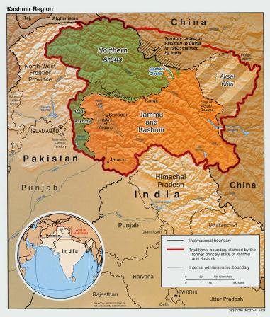
Jammu and Kashmir
Notes:
This is the current map of J&K. The green part if the “Pakistan-occupied Kashmir” (India’s view) or the “Azaad Kashmir” (Pakistan’s view). The orange part is controlled by India and the Aksai Chin region to the north-east of J&K is controlled by China. The Aksai-Chin issue can be studied in the later history of how the war of 1962 happened.

Slide 41
The Constitution
1946-49
Notes:
The framing of the constitution was critical in we becoming a republic. There must a framework written down explicitly on the basis of which a nation must be governed. This framework has a lot of different aspects, political, social and philosophical.

Slide 42
The Team
Constituent Assembly (formed in 1946)
Over 300 members in all
Boycotted by Muslim League
Notes:
To frame the constitution, Constituent Assembly was formed in 1946. It had around 300 members and had the representation from lot of different communities and groups. About 82% of the members were already the part of Congress and others came from independent groups or individuals. Noting, the Muslim League boycotted this since it had already won a handsome number of seats in the elections and was fighting for a separate country for the Muslims.

Slide 43
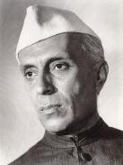
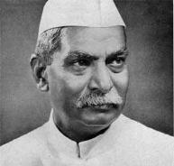
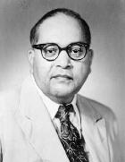
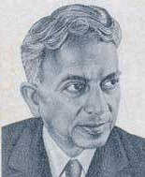
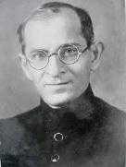
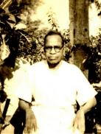
Some key members
Jawaharlal Nehru
Vallabhbhai Patel
Rajendra Prasad
B. R. Ambedkar
B.N. Rau
K. M. Munshi
Alladi Krishnaswami
Notes:
Here I want to name some key members of the Constituent Assembly who played a key role. Jawaharlal Nehru – the prime minister, Sardar Vallabhbhai patel – the home minister, Rajendra Prasad – first President after 1950, B.R. Ambedkar – a brilliant lawyer, Alladi Krishnaswami – chancellor of the state of the Madras for about 15 years, K.M. Munshi – a known lawyer and B.N. Rau, who was not a part of the constituent assembly but was in an advisory role to the team.

Slide 44
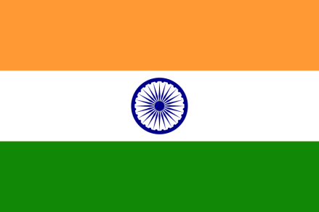
The National Flag
July 22, 1947
Notes:
On July 22, 1947, Nehru introduced the proposal for the national flag which was finally accepted. The members gave different interpretations to it, each saying how different colors in the flag represented the different communities and their contributions.

Slide 45
Basic Outline
Individual vs Village
Euro-American vs Indian precedents
British system – PM, Cabinet, Lower and Upper Houses, Nominal President.
Fundamental rights and Directive Principles
Some complaints – “wanted the music of Veena or Sitar but instead got the music of an English band”
Notes:
There were some key questions when the team decided to design the framework of the Constitution. What would be the smallest unit of governance? Is it the individual or the village? The villages had been these units in the governance systems that existed centuries before. Finally the individual was chosen as the unit with the right to vote. Another big question or debate was about modeling the constitution on western ones that had come up a century or two before or the ones that existed in our country before. The assembly found the British system good and chose a system were a Prime Minister assisted by a cabinet of ministers would form the government at the center along with a President who would be the nominal head of the state. There would be two houses of representatives chosen by direct and indirect voting. The same thing was replicated at the state level. Further Fundamental rights and Directive principles were added to guide the law formation with the care of citizens in the minds. Some of the members were not happy with the decisions saying that we had been over-influenced by the Western constitutions and tried to copy them while we should have looked more at the Indian precedents like Chanakya’s.

Slide 46
Rights of the States
Push to centralization.
Were states the “beggars at the doors of Centre”?
Need of a strong center instead of current “weak and vacillating executives in provinces”.
Notes:
A contentious issue was the power distribution between the Center and the State. The current constitution divides the governance rights on vaious topics into three lists – Federal (to be governed by state), State (to be governed by states) and Concurrent (to be governed by both). The states argued that the Center had a lot of power and the states were merely beggars. But the leaders argued hat a strong Center was needed at that point of time since we had just got independent and we need one controlling body to provide the thrust towards the development and that there were not enough good leaders to govern states at that point of time. Maybe that reason hold true then, but we can think if it is time now to pass on some of the governing powers to the states. This might reduce red-tapism and may reduce the feeling of discrimination among some states to others.

Slide 47
Minority Rights
Muslim reservations
Vallabhbhai Patel –
  “Those who want that kind of a thing have a place in Pakistan, not here.”
  “Here, we are building a nation and those who choose to divide again and sow seeds of disruption will have no place here….”
Notes:
The issue of minority rights was a critical one. While the reservations are a useful tool to allow opportunities for some people, at the same time it can also act as a divisive mechanism between the communities. The first such case as the demand for reservation for the muslims. The argument for this was that this would help prove to the world and the muslims that India was indeed a secular country. But the home minister Sardar Patel, shot down this idea immediately since he did not want to create religious divisions once again in the nation that was still coping with the aftermath of a religion-based division.

Slide 48
Minority Rights
Women reservations
The lone fighter was a man – R. K. Chaudhuri, from his “experience as a parliamentarian and a man of the world.”
Notes:
Another proposed reservations was for women. But all the women members in the Assembly shot this down saying that the women do not need any special reservations and that they can come up on their own. The only person supporting women’s reservations was a man – P.K. Chaudhuri who was saying so “from his experience”. But the demand was turned down then. Though today we have reservations for women in the Parliament.

Slide 49
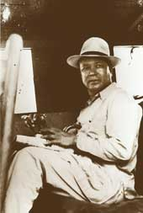
Minority Rights
Untouchables, Tribal community.
Support led by Jaipal Singh.
Agreed after studying scale of exploitation.
Notes:
Another major issue which also created a lot of ripples across India a few years back is the one about reservations for the different classes. The issue was led by Jaipal Singh who presented a very strong case for the reservations for the untouchables and tribal communities. He said that these people had been exploited for very long now and needed this sort of mechanism to come up. The fear amongst the other leaders was that if reservations were implemented, they would only benefit the cream of these classes and not have the desired effect. This is the argument that still comes into picture today. But after a lot of debate and effort by Singh, the reservations for these classes was implemented.

Slide 50
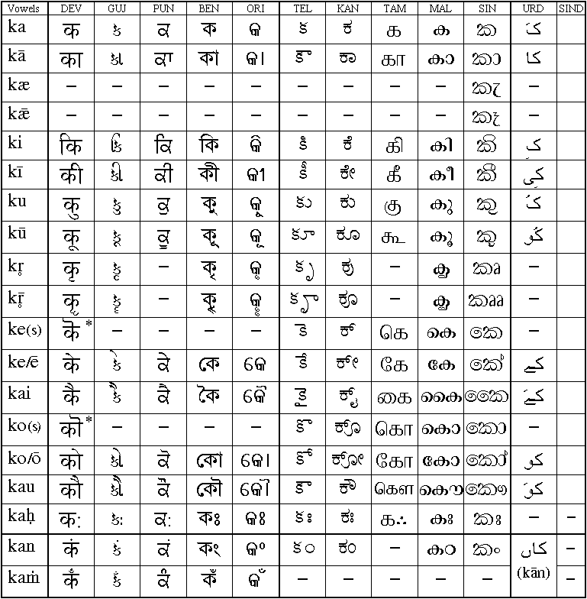
The Language(s)?
English – Inherited language of communication from British.
Notes:
One of the biggest and most contentious issues was the language of the nation, or rather the languages. There are about 18-20 major languages that are mentioned in the constitution. Which of these languages would be used to conduct all proceedings, possible of medium of instruction in schools, and as a medium of inter-provincial communication. English had been used for all these purposes till now but the case against it was that it was a sign of British supremacy. There was a strong move to establish Hindi as the official language. But the non-Hindi speaking states were totally against it and saw it as a North-Indian domination. They were in favor of English continuing as the official language.

Slide 51
The Language(s)?
English – Inherited language of communication from British.
Official language – Hindi but till 1965, procedures conducted in English.
Notes:
No consensus could be reached on the language issue so in the constitution, it was decided that till 1965 English will be used as the official language and then Hindi will take over. The idea was that this will give enough time for the current non-Hindi speaking states to start using Hindi. But when 1965 came, the country again saw big protests against Hindi. I am not covering what happened then but as of today, India does not have any national language. Hindi and English are the official languages while some states conduct official proceedings in their own language additionally. This is an important issue to think about since it relates to the unity of India. This again came up some years later then when there was the ask of reorganizing the state boundaries based on the language. It is a separate chapter in itself and maybe I’ll cover it some later talk.

Slide 52
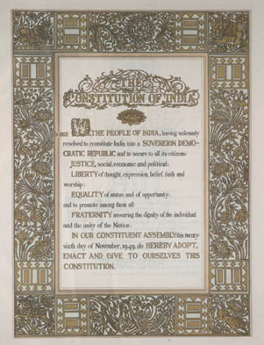
Final Constitution Drafted
Nov 25, 1949
Longest in the world
  395 articles
  8 schedules
Notes:
Finally, after all these discussions for around a period of 2 years, the Assembly wrapped up the final draft of the Indian Constitution on Nov 25, 1949. It is the longest constitution in the world with 395 articles and 8 schedules.

Slide 53
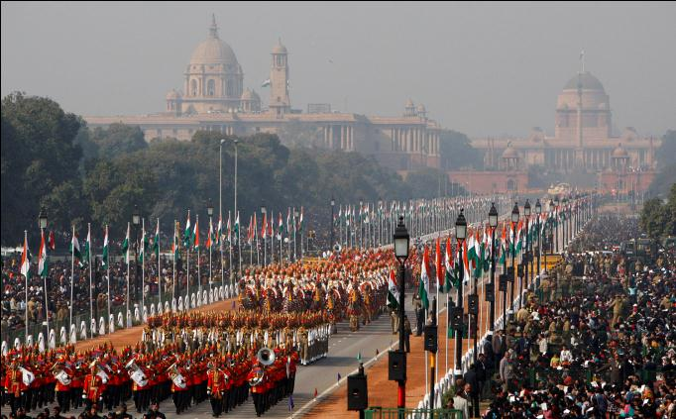
The Republic of India
January 26, 1950
Notes:
On January 26, 1950 Indian adopted its new constitution and became the Republic of India. Note that we chose Jan 26 as the date of becoming the republic since its connection with the declaration of the Purna Swaraj in 1930. In this picture, you see the military parade that happens every year at Rajpath, India Gate, Delhi on the Republic Day. In the picture’s background you see the Rashtrapati Bhavan, house of the President of India.

Slide 54
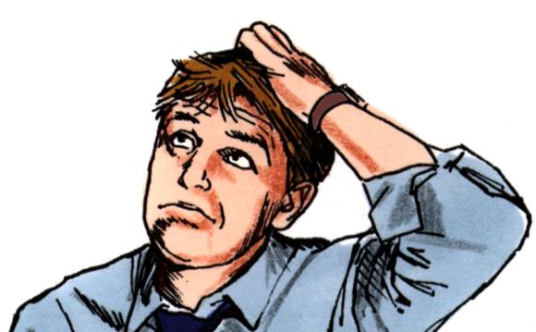
Conclusion
Notes:
I don’t really have a conclusion to this talk.

Slide 55
We started a quest today.
A Quest to understand India.
Notes:
But what I can say is that we started a quest today, a quest to understand India. And in the end, I would like to leave you all with one question. A question that motivated me start reading about this topic and to present today.

Slide 56

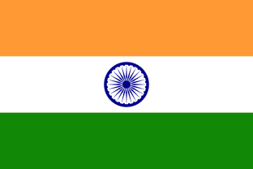
What unites India?
Notes:
What defines India? What is India? What do we mean when we call ourselves Indian? Is it just something related to being born there or is it deeper than that? With so many religions, languages, cultures, what unites us? What can we all call as ours?
Today, when there are parts of the country who protest to get independence or to become separate states, we need to evaluate the question of what do we gain or lose by taking any decision. It is then that these questions come up and force people like me to undergo this quest of understanding India. I hope that maybe if not all, but some of you will feel motivated enough to think about these questions after going back.

Slide 57
References
India After Gandhi. (By Shri Ramachandra Guha)
Wikipedia
Notes:
For the presentation, I read a lot of wikipedia articles and mainly the book – “India after Gandhi”.
But whenever you decide to read a book on history, bear in mind that it is always biased. The bias could be towards a particular person, a particular organization or for a whole event. So it is good to analyze the facts presented rather than the opinions, possibly from multiple sources, and then make your interpretation of what was the situation like.

Slide 58
Thank you

